Slide 1

Introduction to Java
Rajesh Palit, Ph.D.
Electrical and Computer Engineering
North South University

Slide 2
Computer Programming
A computer program is a set of instructions to the computer telling it what to do. Programming is the creation of a program executable by a computer and performs the required tasks
Computers do not understand human languages, so we need to use computer languages in computer programs
A computer’s native language is a set of built-in primitive instructions. The instruction set is in the form of binary code and differs among different types of computers
Programming in machine language is a tedious process. Moreover, the programs are highly difficult to read and modify
To add two numbers, we might have to write an instruction in binary like this 1101101010011010

Slide 3
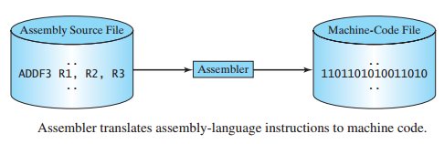
Assembly Language
Assembly language is a low-level programming language in which a mnemonic is used to represent each of the machine language instructions. For example, to add two numbers, we might write an instruction in assembly code like this: ADDF3 R1, R2, R3
Since the computers cannot understand assembly language, a program called an assembler is used to convert assembly-language programs into machine code

Slide 4
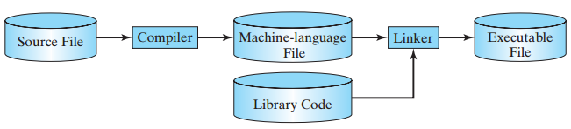
High Level Programming Languages
As program size grows, assembly program becomes unmanageable
The high-level languages are English-like and easy to learn and program. Here, for example, is a high-level language statement that computes the area of a circle with radius 5: area = 5 * 5 * 3.1415;

Slide 5
Prominent High Level Programming Languages
COBOL (COmmon Business Oriented Language)
FORTRAN (FORmula TRANslation)
BASIC (Beginner’s All-purpose Symbolic Instruction Code)
Pascal (named for Blaise Pascal)
Ada (named for Ada Lovelace)
C (developed by the designer of B)
Visual Basic (Basic-like visual language by Microsoft)
Delphi (Pascal-like visual language developed by Borland)
C++ (an object-oriented language, based on C)
C# (a Java-like language developed by Microsoft)
Java

Slide 6
Why Java?
The answer is that Java enables users to develop and deploy applications on the Internet for servers, desktop computers, and small hand-held devices
The future of computing is being profoundly influenced by the Internet, and Java promises to remain a big part of that future. Java is the Internet programming language
Java is a general purpose programming language as well as the Internet programming language
Java is purely Object Oriented Programming Language

Slide 7
History of Java
James Gosling, Mike Sheridan, and Patrick Naughton initiated the Java language project in June 1991 in Sun Microsystem
Java was originally designed for interactive television, but it was too advanced for the digital cable television industry at the time
The language was initially called Oak after an oak tree that stood outside Gosling's office
It went by the name Green later, and was later renamed Java, from Java coffee said to be consumed in large quantities by the language's creators
Public in Sun World: May 20, 1995

Slide 8
Java Development Kit (JDK) Versions
JDK 1.02 (1995)
JDK 1.1 (1996)
JDK 1.2 (1998)
JDK 1.3 (2000)
JDK 1.4 (2002)
JDK 1.5 (2004) a. k. a. JDK 5 or Java 5
JDK 1.6 (2006) a. k. a. JDK 6 or Java 6
JDK 1.7 (2011) a. k. a. JDK 7 or Java 7
JDK 1.8 (2014) a. k. a. JDK 8 or Java 8

Slide 9
JDK Editions
Java Standard Edition (J2SE)
J2SE can be used to develop client-side standalone applications or applets.
Java Enterprise Edition (J2EE)
J2EE can be used to develop server-side applications such as Java servlets and Java ServerPages.
Java Micro Edition (J2ME).
J2ME can be used to develop applications for mobile devices such as cell phones.
This book uses J2SE to introduce Java programming.

Slide 10
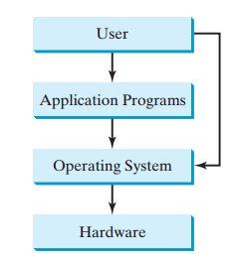
Application Program and Operating Systems (OS)
The operating system(OS) is the most important program that runs on a computer, which manages and controls a computer’s activities
OS abstracts the hardware from the users
Users do not need to know the details of the HW
Using application programs such as a web browser or a word processor, users utilize hardware components through OS

Slide 11
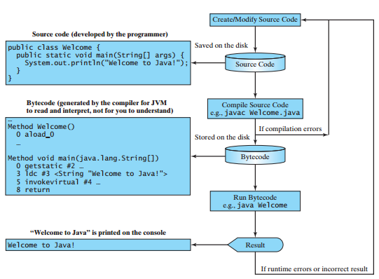
Java Program Execution

Slide 12

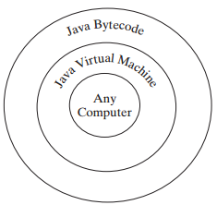
Java Bytecode and JVM
Java source file using any text editor such as Eclipse, NetBeans, TextPad or Notepad++
Compile the source codes javac source.java, and execute java source
Integrated Development Environment (IDE): Netbeans / Eclipse
JVM for every platform
Compile once, run anywhere

Slide 13
A Sample Java Program
//This program prints Welcome to Java!
public class Welcome {
public static void main(String[] args) {
System.out.println("Welcome to Java!");
}
}
The name of the source file must be Welcome.java
This program prints: Welcome to Java!

Slide 14
Anatomy of a Java Program
Comments
Reserved words
Modifiers
Statements
Blocks
Classes
Methods
The main method

Slide 15
Smallest Java Program
public class Smallest
{
public static void main(String[] args)
{
}
}

Slide 16
IDE
Eclipse
Command Prompt
javac program_name.java
Java program_name

Slide 17
Unified Modelling Language
UML is a diagramming tool for describing and documenting object oriented applications
Programming language independent
Used for modelling an application before its engineered
Twelve different diagrams in all, with many complex details
Generally though only two of these are used regularly
Class diagrams
Sequence diagrams
Notes:
The reason I’m introducing a few UML basics is because it makes talking about applications much easier, as we can produce a diagram describing the classes and their relationships, rather than just jumping into the code.
It’s also a useful skill in its own right, and is generally encountered in OO design documents.

Slide 18
Unified Modelling Language
Class Diagrams
Describe classes and interfaces
…their properties
…their public interface
…and their relationships (e.g. inheritance, aggregation)
Sequence Diagrams
Describe how objects send messages to one another
Useful for describing how a particular part of an application works
We’ll be covering just class diagrams
Very useful for describing APIs and discussing OO applications

Slide 19
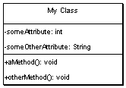
UML -- Classes
Box with 3 sections
The top contains the class name
The middle lists the classes attributes
The bottom lists the classes methods
Can indicate parameters and return types to methods, as well as their visibility

Slide 20
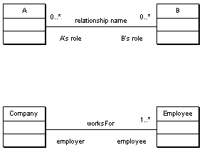
UML -- Association
A line between two classes indicates a relationship
Extra information can be added to describe the relationship
Including
Its name
The roles that the classes play
The cardinality of the relationship (how many objects are involved)
E.g. a Person worksFor a Company, which has many employees

Slide 21
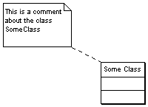
UML -- Comments
Useful for adding text for the readers of your diagram
The symbol looks like a little post-it note, with a dotted line joining it to the class or relationship that its describing

Slide 22

UML -- Aggregation
Aggregation (a whole-part relationship) is shown by a line with clear diamond.
As aggregation is a form of relationship you can also add the usual extra information
I.e.
Name
Roles
Cardinality

Slide 23
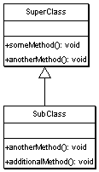
UML -- Inheritance
Inheritance is shown by a solid arrow from the sub-class to the super-class
The sub-class doesn’t list its super-class attributes or methods,
unless its providing its own alternate version (I.e. is extending the behaviour of the base class)

Slide 24
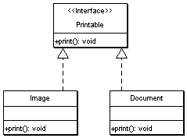
UML -- Interfaces
Interfaces are a way to specify behaviour (a public contract) without data or implementation.
Interfaces are classed with an extra label next to their name: <<Interface>>
A dotted arrow from a class to an interface explains that the class fulfills the contract specified by that interface

